Slide 1

Getting you ready for the summer exam series:
A student guide

Slide 2

Summer 2025 exam series
The exam boards have a set of rules which all students must follow when taking their exams. These rules cover:
  Before the exam
    You need to know which exams you have been entered for, and when they take place
  During the exam
    You need to know the rules you need to follow in the exam room
  After the exam
    You need to know when and how you will receive your results, and what to do if you think an error might have been made with your grade(s)

Slide 3
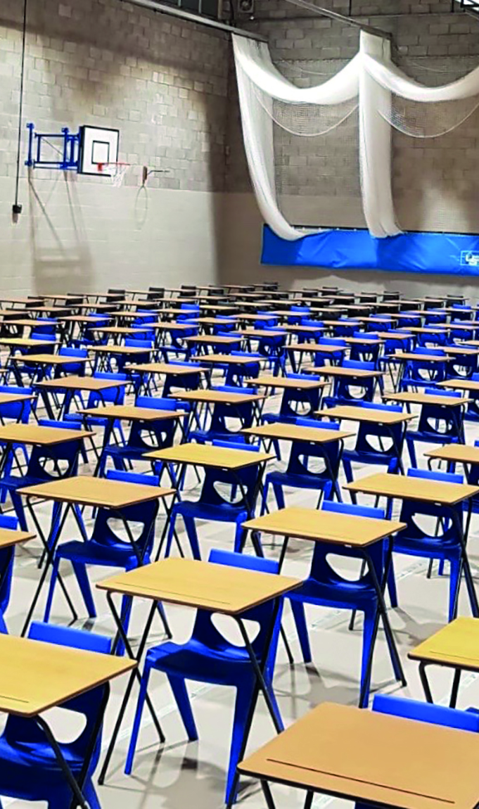
Exam entries
You will be provided with information about the exams you are taking this summer in the form of a Candidate Statement of Entry and an Exam Timetable. You must check these documents for:
Accuracy. Tell the exams officer if:
  you think you have been entered for an incorrect exam
  you have not been entered for an exam which you think you should be sitting
  your personal details are incorrect
Exam day arrangements
  Be aware of the date, time and location (room) of all your exams /assessments
Exam clashes
  Ensure that you know what to do if you have two or more exam papers timetabled at the same time (this is known as a timetable clash)

Slide 4
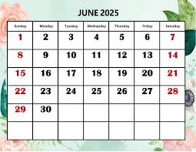
Contingency sessions
Even if you do not have any exams taking place on the following days/sessions, you are expected to make yourself available at these times in case they are used in the event of an emergency:
  Wednesday 11 June (afternoon)
  Wednesday 25 June (all day)

Slide 5
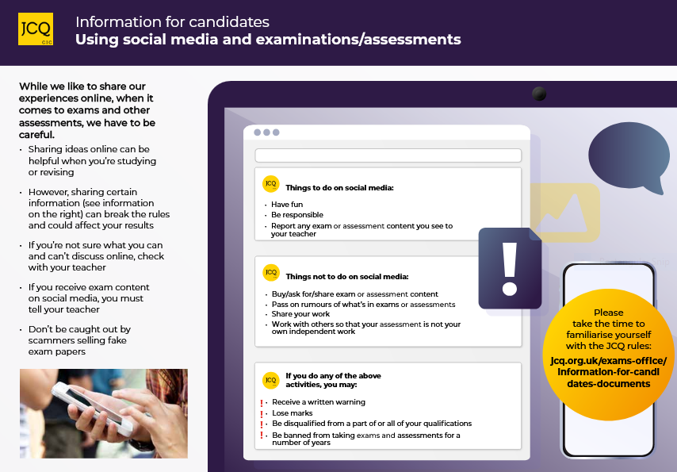

Social media poster
DO NOT COMMENT ON OR DISCUSS THE CONTENT OF THE QUESTION PAPER ON SOCIAL MEDIA

Slide 6
The Exam Day
You must be aware of the following before your exams:
  In which room(s) your exams will be taking place
  What time each of your exams will be starting (and finishing)
  Where you will be sitting during each exam
  Where your personal belongings will be kept, for example your bag, mobile phone etc.

Slide 7
What you need to do if you are late for an exam
You must be on time for all of your exams
However, if you are/you think you will be late for an exam, follow these steps:
Step 1: Telephone the school and ask to speak with the exams officer
Step 2: Follow the instructions given by the exams officer
Step 3: Turn off your mobile phone and any other communication device
Step 4: When you arrive at school go to reception and explain that you are late and that you need to see the exam officer immediately
Step 5: Your exams officer (or an invigilator) will give you the full instructions for the exam, and answer any questions, before you are allowed to begin your exam

Slide 8
What you need to do if you are ill on the day of an exam
If you are feeling unwell on the day of an exam, follow the steps below
Step 1: Telephone the school and ask to speak with the exams officer
Step 2: Follow the instructions given by the exams officer
Step 3: Try and get some evidence to prove your illness (e.g. a doctor’s note)

Slide 9
Access Arrangements
The special educational needs co-ordinator (SENCo), or the exams officer, will inform you of how your access arrangement(s) will be delivered on the day of the exam
Access arrangements include:
  Use of a reader
  Use of a scribe
  Extra time
  Supervised rest breaks

Slide 10

Exam room posters
You are not allowed to bring potential technological / web enabled sources of information into the exam room including:
Mobile phone/smartphone
Any type of watch (Smartwatch, digital or analogue)
Smart glasses (or any Smart device)
AirPods
Earphones/earbuds
iPod
MP3/4 player
Memory sticks

Slide 11
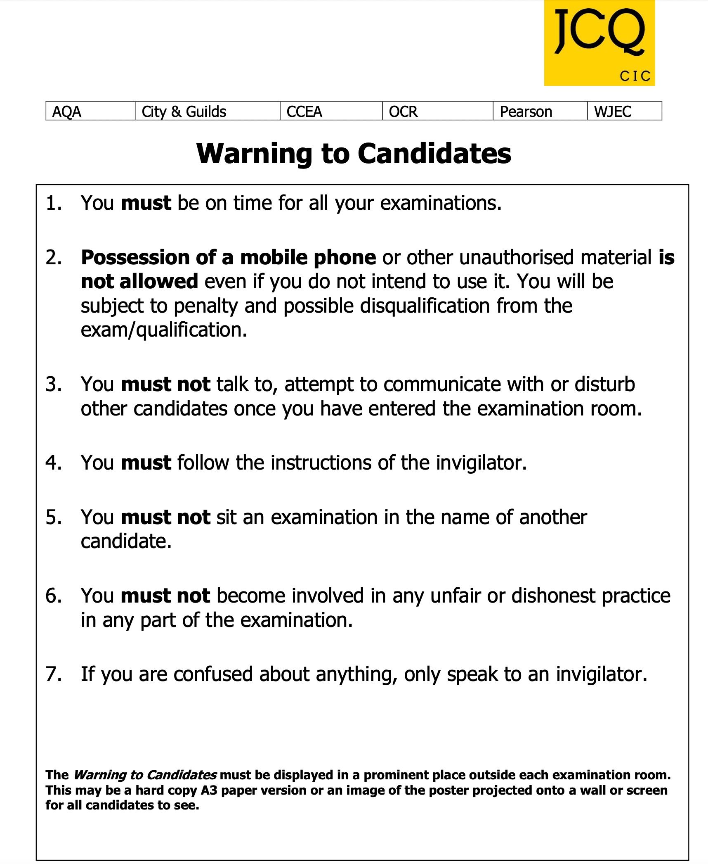
Exam room posters
In particular, note the following:
Possession of a mobile phone, even if you do not use it, is not allowed and may be subject to penalty, including possible disqualification
You are under formal exam conditions from the the moment you enter the room in which you will be taking your examination(s) until the point at which you are permitted to leave
You must follow the instructions of the invigilator
If you do not follow these instructions you are committing malpractice

Slide 12
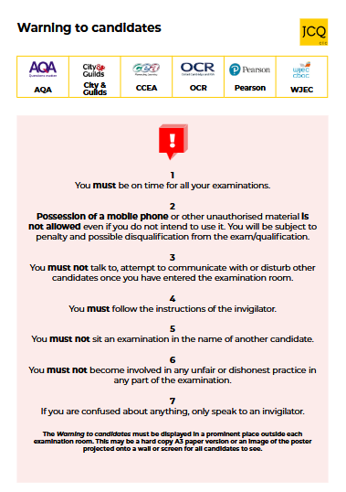
Exam room posters
In particular, note the following:
Possession of a mobile phone, even if you do not use it, is not allowed and may be subject to penalty, including possible disqualification
You are under formal exam conditions from the the moment you enter the room in which you will be taking your examination(s) until the point at which you are permitted to leave
You must follow the instructions of the invigilator
If you do not follow these instructions you are committing malpractice

Slide 13
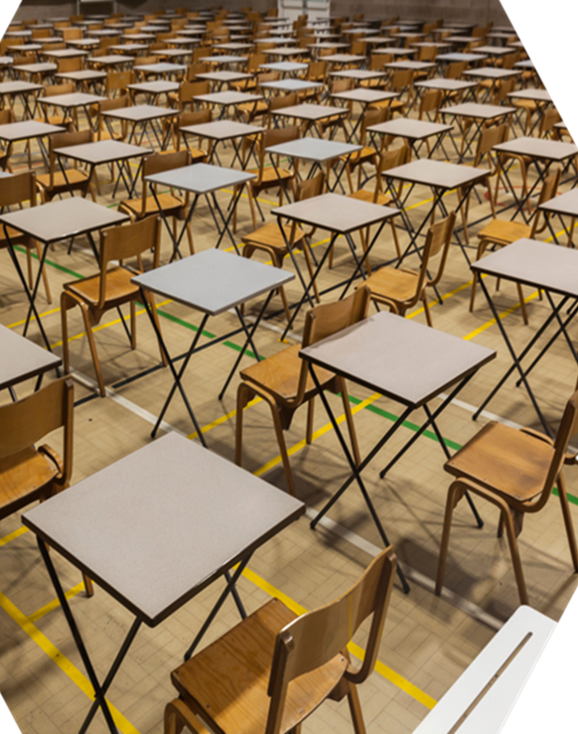
What are formal exam room conditions?
Formal examination/exam room conditions are:
  Not talking to other candidates
  Not disturbing other candidates
  Not communicating with other candidates
You are under formal examination conditions from the moment you enter the exam room in which you will be taking your examination(s) until the point at which you are permitted to leave
If you talk to, disturb and/or communicate with other candidates as you enter or leave the exam room (as well as the whole time you are in the exam room), this is malpractice and will be reported to the awarding body who will decide whether to penalise you which may include disqualification

Slide 14

The role of the invigilators
Each exam room will have at least one invigilator
Awarding bodies insist that invigilators must follow strict rules and regulations during exams
Invigilators must record any irregular incidents which occur in the exam room (e.g. if someone feels unwell, requires the toilet or falls asleep etc.)
If you behave in a suspicious manner the invigilator will approach you and ask you to stop
If you misbehave, the invigilator will warn you that you may be removed from the exam room
You are committing malpractice if you do not follow the invigilator’s instructions
YOU MUST FOLLOW THE INSTRUCTIONS OF THE INVIGILATOR. FAILURE TO DO SO MAY RESULT IN A PENALTY WHICH COULD INCLUDE POSSIBLE DISQUALIFICATION

Slide 15
Exam room regulations
PLAY THE INSTRUCTIONS FOR CANDIDATES VIDEO:
https://youtu.be/-U0gqU0SuAE

Slide 16
Exam room conditions
How each exam room will be set up
How you will enter the exam room
Formal exam conditions apply
Follow the invigilator’s instructions
Exam information
Completing the front of your answer booklet
Additional answer sheets/ booklets
Once you have entered the exam room:
Do not talk to other candidates
Do not disturb other candidates
Do not communicate with other candidates
Your invigilator will ensure that the following are in place inside/outside the exam room:
Exam room posters
Adequate room conditions (heating, lighting, ventilation, noise etc.)
Clock
Relevant exam information displayed
For each exam:
Centre number
Subject title
Paper number
Starting & finishing times
Date

Slide 17

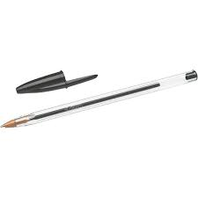
What materials should you bring to an exam
You must bring the following materials with you to every examination:
Pens
Pencils
Ruler
Protractor
Calculator
Compass
Spare pencils and pens
Highlighters
Water bottle with no label or writing

Slide 18
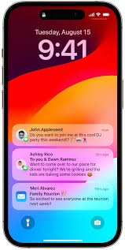
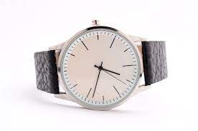
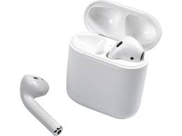

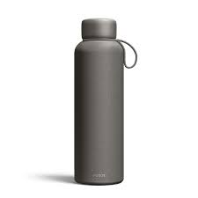
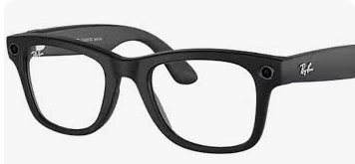
What material is not allowed in the exam room

Slide 19
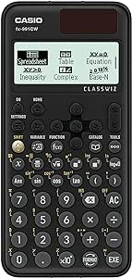

Calculators
How a calculator can/cannot be used in an exam
During an exam, a calculator must not be able to offer any of these facilities:
language translators
symbolic algebra manipulation
symbolic differentiation or integration
communication with other machines or the internet
During an exam, a calculator must not give access to pre-stored information, including:
Databanks, such as the periodic table (with the exception of scientific constants)
dictionaries
mathematical formulae
text
Your Maths teacher will explain how a calculator can/cannot be used in an exam

Slide 20


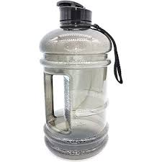


Drink bottles
Drink bottles must be transparent with all labels removed
This includes transparent, reusable plastic bottles
The invigilator may ask you to take off the lid if this is large enough to hide notes

Slide 21

Emergency evacuation of the exam room
If there is an emergency, such as a fire alarm, the exam room will be evacuated
This video shows how your invigilators are instructed to evacuate the exam room
You must follow the invigilator’s instructions
PLAY THE DEALING WITH EMERGENCIES VIDEO:
https://youtu.be/TxzZhK8R0m0

Slide 22
What is malpractice?
Any form of communication
Not following the instructions of an invigilator
Disruptive behaviour in the exam room (including the use of offensive language)
Bringing unauthorised notes, study guides and personal organisers into the exam room
Mobile phone or similar electronic devices (including iPod, MP3/4 player, memory sticks, smartphone, smartwatch, AirPods, earphones and headphones)
Malpractice
Exchanging, obtaining, receiving, or passing on information which could be exam related (or attempting to)
Introducing unauthorised material into the exam room
Undermining the integrity of the exams/ assessments
Breaches of exam conditions
Offences relating to the content of the candidates’ work
Writing/drawing offensive or obscene material
Copying from sources without referencing (including the internet and Artificial Intelligence tools) and misusing technology
Sharing, copying work or allowing your work to be copied
Behaving in a way which is not allowed in the exam room
Sitting the exam in another person’s name
Using social media to exchange and spread real or fake exam material

Slide 23
Examples of malpractice and the penalties which may be applied
Offence | Warning | Loss of marks on that paper | Loss of marks on all papers in that subject
Bringing notes in the wrong format or prohibited annotations into the exam room | Notes/annotations go beyond what is permitted but do not give an advantage; content irrelevant to subject | Notes/annotations are relevant and give an unfair advantage | Notes/annotations introduced in a deliberate attempt to gain an advantage
Mobile phone or similar electronic devices (including iPod, MP3/4 player, memory sticks, smartphone, smartwatch, AirPods, earphones and headphones) | Not in the candidate’s possession but makes a noise during the examination | In the candidate’s possession but no evidence of being used by the candidate | In the candidate’s possession and evidence of being used by the candidate

Slide 24
Examples of malpractice and the penalties which may be applied
Offence | Warning | Loss of marks on that paper | Loss of marks on all papers in that subject
A breach of the instructions or advice of an invigilator, supervisor, or the awarding body in relation to the exam rules and regulations | Minor non-compliance: e.g. sitting in a non-designated seat; continuing to write for a short period after being told to stop | Major non-compliance: e.g. refusing to move to a designated seat; significant amount of writing after being told to stop | Repeated non-compliance
Disruptive behaviour in the examination room or assessment session (including use of offensive language) | Minor disruption lasting a short time; calling out, causing noise, turning around | Repeated or prolonged disruption; unacceptably rude remarks; being removed from the exam room; taking another’s possessions | Warnings ignored; provocative or aggravated behaviour; repeated or loud offensive comments; physical assault on staff or property

Slide 25
Examples of malpractice and the penalties which may be applied
Offence | Warning | Loss of marks on that paper | Loss of marks on all papers in that subject
The inclusion of offensive or obscene material in scripts, controlled assessments, coursework, non- examination assessments or portfolios | Isolated offensive words or drawings | Frequent offensive words or drawings; isolated obscenity or offensive comments directed at an individual or group | Frequent obscenities; discriminatory language, remarks or drawings directed at an individual or group
Copying from another candidate or allowing work to be copied (including the misuse of technology) | Lending work not knowing it would be copied | Permitting examination script/work to be copied; showing other candidates’ answers | Copying from another candidate’s script, controlled assessment, coursework, non- examination assessment; borrowing work to copy

Slide 26

Leaving the exam room
If you need to go to the toilet during an exam, make sure you give sufficient notice to the invigilator as they will need to call for support from another member of staff.
Put your hand up, tell the invigilator, wait for them to arrange someone to come and escort you to the toilet and back. They will check the cubicle before you enter for notes or any malpractice set ups.

Slide 27
Leaving the exam room
For examinations that last one hour or more, candidates must stay under centre supervision until 10.00am for a morning examination or 2.30pm for an afternoon examination, i.e. one hour after the awarding body’s published starting time for that examination (ICE 23.1)
For examinations that last less than one hour, candidates must be stay in the exam until the published finishing time of the examination (ICE 23.2)
Candidates who have finished the examination and have been allowed to leave the examination room early must hand in their script, question paper and any other material before they leave the examination room. Those candidates must not be allowed back into the room (ICE 23.6)

Slide 28
Leaving the exam room:
Extra time candidates
If you have been granted extra time and you finish before the end of your extra time we strongly advise you wait until the end of the exam.
If you do not use your full extra time on a regular basis, you could possibly lose this arrangement for your remaining exams

Slide 29
Results
Most people will collect their results from school.
If you’re going to be away, make sure you let the Exams Office know in advance so that you can arrange for your results to be sent by post or email
Come to reception and collect the envelope with your results between 9 and 10am.
Give yourself plenty of time to get to school and make sure you know how you’re getting there. Think about whether you want to rip open your results on the spot or take them somewhere quieter. You may need time to absorb and process your results, and it’s up to you whether you do this at school, surrounded by classmates and teachers, or privately at home.
If you need additional support after receiving your results staff will be at school to help.
The National career service https://nationalcareers.service.gov.uk/ can also help. You may need extra support and this is a great resource offering advisers via phone or webchat.

Slide 30
Reviewing your exam results: The options
Service 1: A clerical re-check. This includes a check that:
  all parts of your script (your answers) have been marked
  marks have been totalled and recorded correctly
Service 2: Review of marking. This includes:
  a review of the original marking to ensure that the mark scheme was applied correctly, and to correct any errors
  a check that all parts of your script (your answers) have been marked, and that marks have been totalled and recorded correctly
Service 3: Review of moderation. This applies to non-examination assessments and coursework and includes:
  a review of the original moderation and sample of candidates’ work to ensure that the assessment criteria was applied fairly, reliably and consistently (this service is not available to individual candidates)
Access to scripts

Slide 31
Requesting a post-results service
To request a post-results service you need to email exams@waldorfcambridge.uk with the details and information.
Please discuss with your teacher before putting in requests.
You will need to pay if there are fees for the service from AQA – see fees on the next slide.

Slide 32
Post-results service | Fee
Priority review of marking (AS and A-level – university place pending) | £57.85 (includes a copy of the reviewed script)
Priority copy of marked paper (AS and A-level) | Free
Priority copy of marked paper (GCSE) | Free
Clerical re-check | £9.05 per unit, component or module
Review of marking | £42.00 for GCSE and other level 1/2 qualifications; £48.65 for AS and A-level and other level 3 qualifications (includes a copy of the reviewed script)
Review of moderation | £252.20 for GCSE and other level 1/2 qualifications; £281.15 for AS and A-level and other level 3 qualifications (or half the normal rate if the cohort is 5 students or fewer)
Original marked script | Free
Copy of checked script (after a clerical re-check) | Free
Appeals | £124.90 for stage 1 (preliminary stage); £214.05 for stage 2 (appeal hearing)

Slide 33
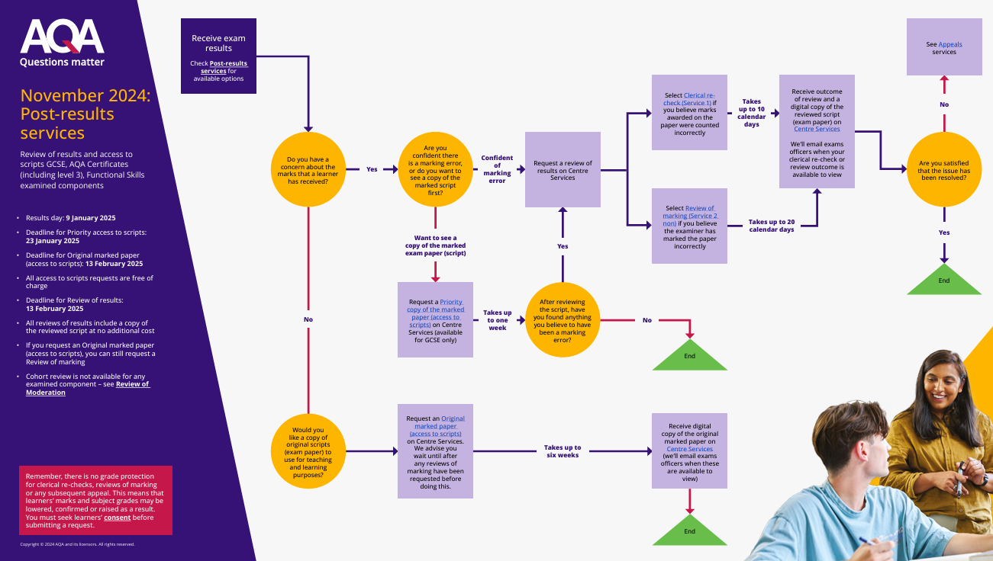

Slide 34
Certificates
Your certificates will be sent to you as soon as we receive them, usually in September or October.

